Slide 1


Arduino Programming

Slide 2
1
2
3 /* “This is a quote, words full of
4 wisdom that someone important said and
5 can make the reader get inspired” */
6
7 -Someone ‘Famous’
8

Slide 3
WHAT IS ARDUINO ?
It is an open source electronics platform with easy to use software and hardware
Software - the famous Arduino IDE
Hardware - Arduino UNO, NANO, Arduino MEGA and many more…

Slide 4
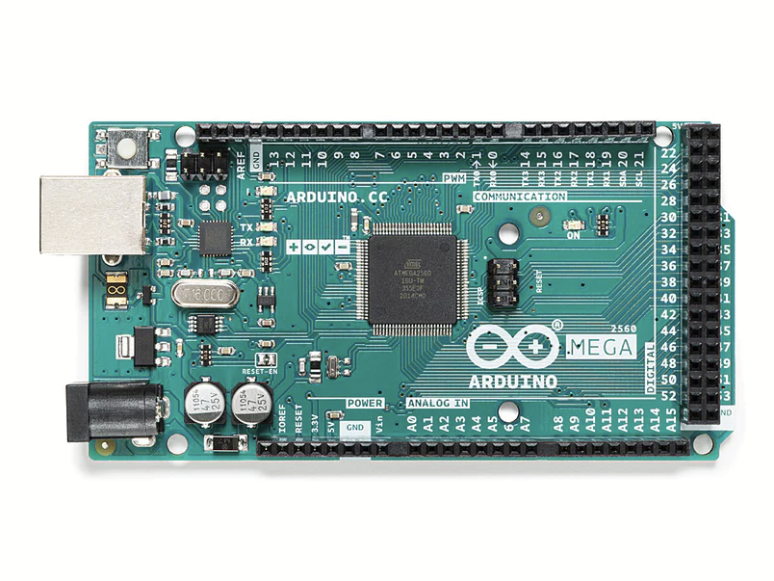
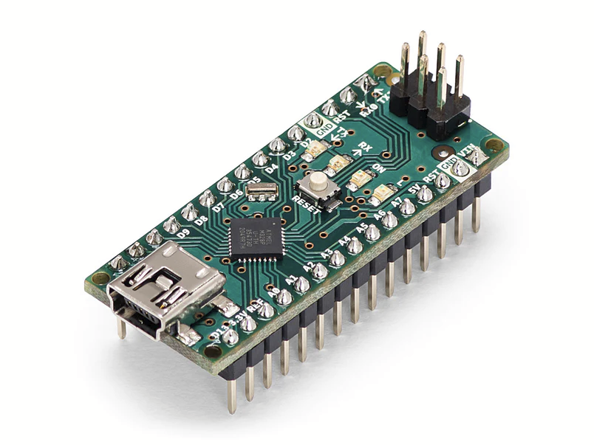
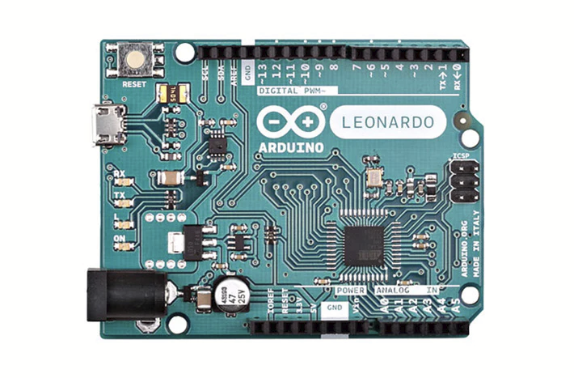
NANO
MEGA
LEONARDO

Slide 5
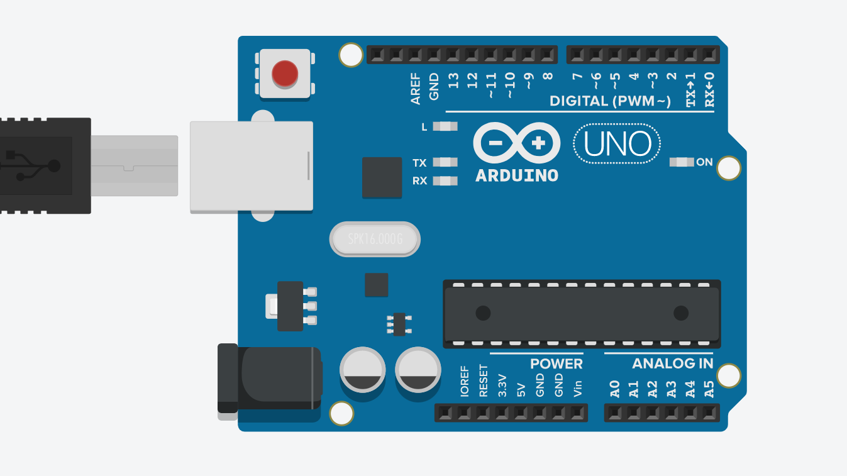

Slide 6
Before starting to code, let’s have an idea of what the board contains

Slide 7
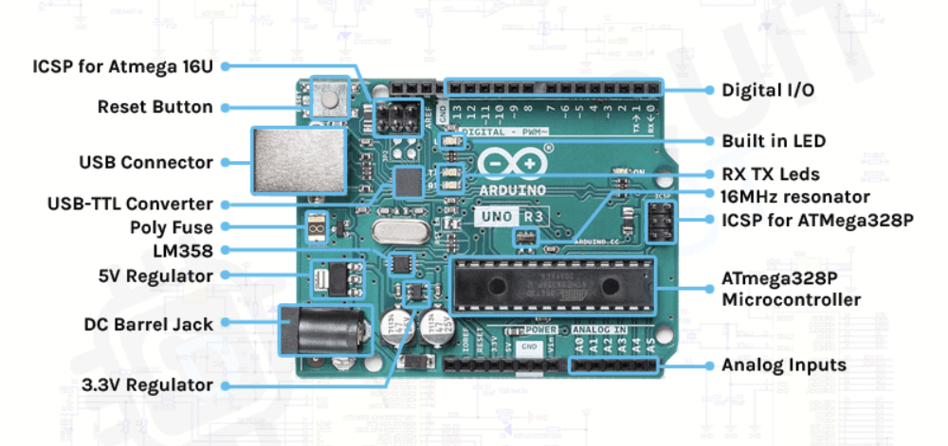
PARTS OF AN ARDUINO BOARD
More details about Hardware - https://docs.arduino.cc/hardware/uno-rev3

Slide 8
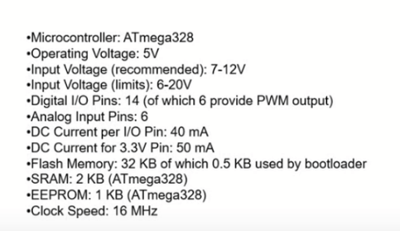
TECHNICAL SPECIFICATIONS

Slide 9
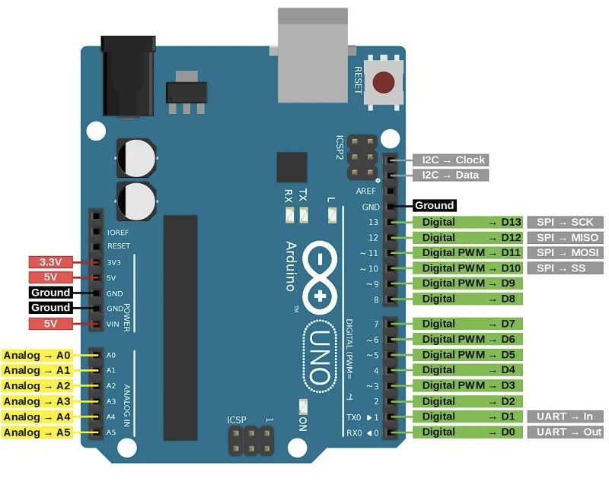

Slide 10
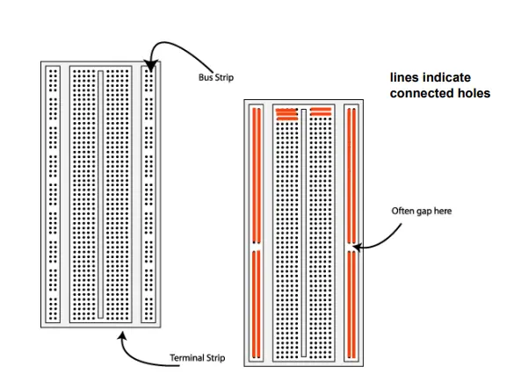
Breadboard

Slide 11
DISCLAIMER
Programming will be taught to you in ID1063:ITP course
Even if you can’t understand things now, ask club members nearby you for help.
It’s OK even if you don’t understand, you will be taught well in that course.

Slide 12


Slide 13
Data Types
Computers know only 0s and 1s. So data is stored in 0s and 1s.
We have to specify what type of value the a certain data is, using data types.
We have the following data types in Sketch: int unsigned int long unsigned long boolean char float

Slide 14
Variables and Constants
A variable is a variable
A constant is a constant

Slide 15
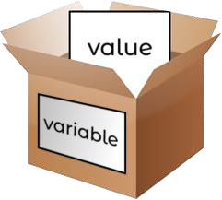
Variables and Constants
Variable is a container for storing data
Variables are just names for values.
Notes:
Explain that you can change the values later.

Slide 16
Variables and Constants
Constant is a data container, but it won’t allow you to change once declared.

Slide 17
Arithmetic Operators
+ addition
- subtraction
* multiplication
/ division
% remainder
= assignment

Slide 18
Logical Operators
< less than
<= less than or equal to
== equal to
>= equal to or greater than
> greater than
!= not equal to
&& and
|| or
! not

Slide 19
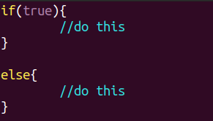
if-else
if-else statement is used to perform the operations based on some specific condition.

Slide 20
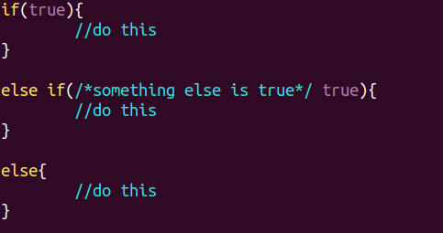
if-else
If you have multiple conditions, you can use else if

Slide 21
loops
Sometimes we need to perform a task repeatedly
Conditional code
Condition
if condition is true
if condition is false

Slide 22
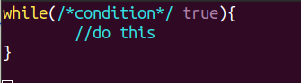
while loop
while loops will loop continuously, and infinitely, until the expression inside the parenthesis, () becomes false. Something must change the tested variable, or the while loop will never exit.

Slide 23
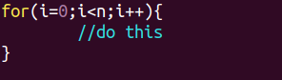
for loop
A for loop executes statements a predetermined number of times. The control expression for the loop is initialized, tested and manipulated entirely within the for loop parentheses.
Notes:
Talk about nested loops and infinite loops

Slide 24
Some Arduino specific functions
pinMode()
digitalRead()
analogRead()
digitalWrite()
analogWrite()
delay()
millis()

Slide 25
pinMode()
Configures the specified pin to behave either as an input or an output.
pinMode(pin,mode)
Example: pinMode(13,OUTPUT)
Sets the pin 13 to behave as an output pin

Slide 26
digitalWrite()
Write a HIGH or a LOW value to a digital pin.
If the pin has been configured as an OUTPUT with pinMode(), its voltage will be set to the corresponding value: 5V (or 3.3V on 3.3V boards) for HIGH, 0V (ground) for LOW.
digitalWrite(pin,value)
Example: digitalWrite(13, HIGH)
Sets the voltage of pin 13 to HIGH (5V or 3.3V depending on board)

Slide 27
digitalRead()
Reads the value from a specified digital pin, either HIGH or LOW.
digitalRead(pin)
Example: val = digitalRead(13)
The value of val becomes the value of pin 13.

Slide 28
delay()
Pauses the program for the amount of time (in milliseconds) specified as parameter. (There are 1000 milliseconds in a second.)
delay(1000)
The program pauses for a second

Slide 29
For further reference:
Arduino Reference page

Slide 30


Slide 31
Structure of Program
Header files These are prewritten reusable codes, which you have include in the start of the program.
Initialize variables, pin modes, start using libraries, etc.
Keep on changing and responding to actively control the arduino board.

Slide 32
#include libraries
/* comments and wiring description */
void setup(){ // setup runs only once
//Setting up program- assign pins,etc.
}
void loop(){ // loop keeps on running
/* here is where you'd put code that needs to be running all
the time.*/
}

Slide 33
HANDS ON TIME

Slide 34
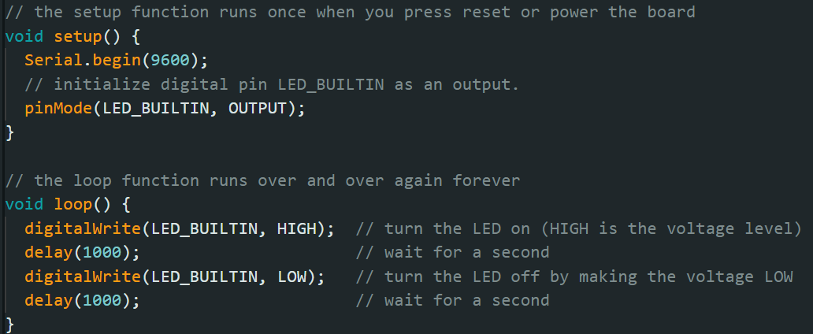
BLINK- “Hello world of Arduino”

Slide 35
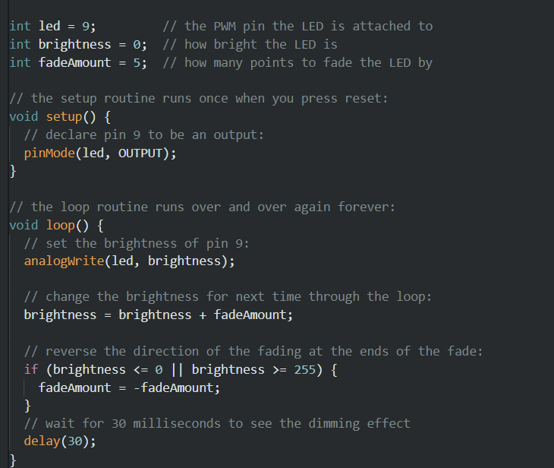
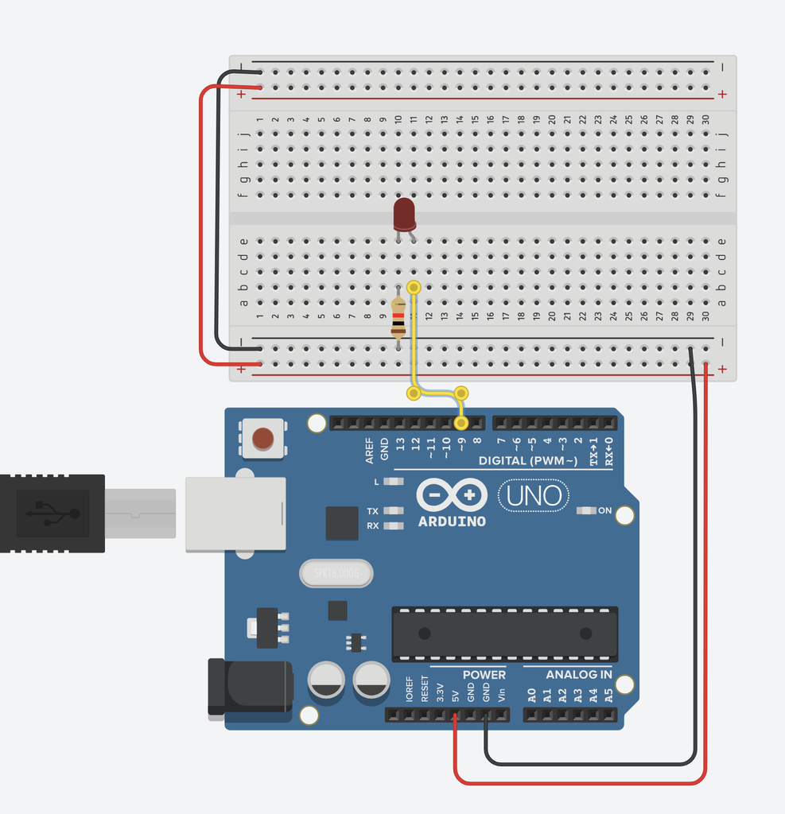
FADING LED

Slide 36
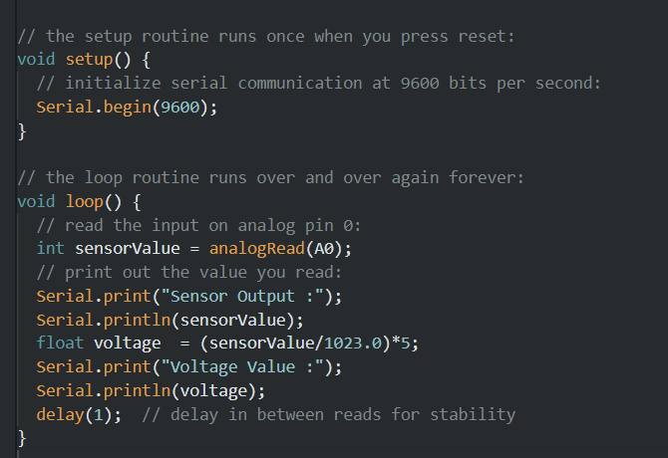
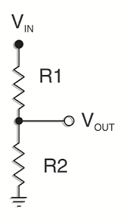
MEASURING OUTPUT VOLTAGE USING ANALOG PINS

Slide 37
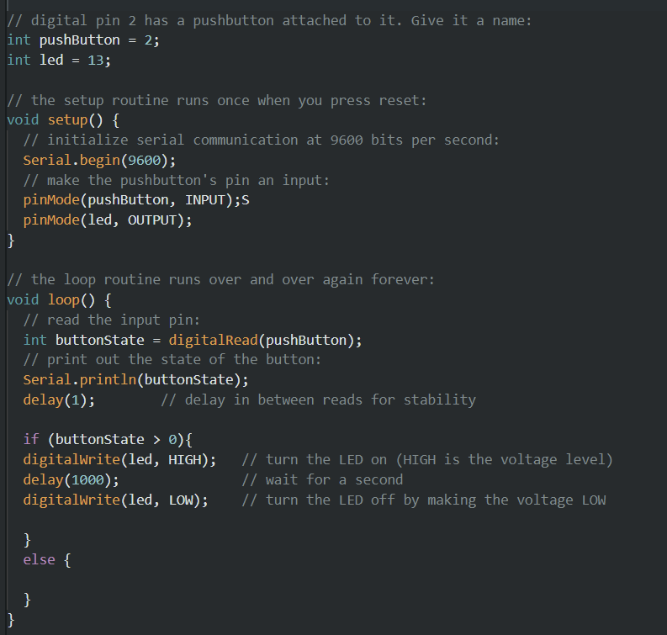
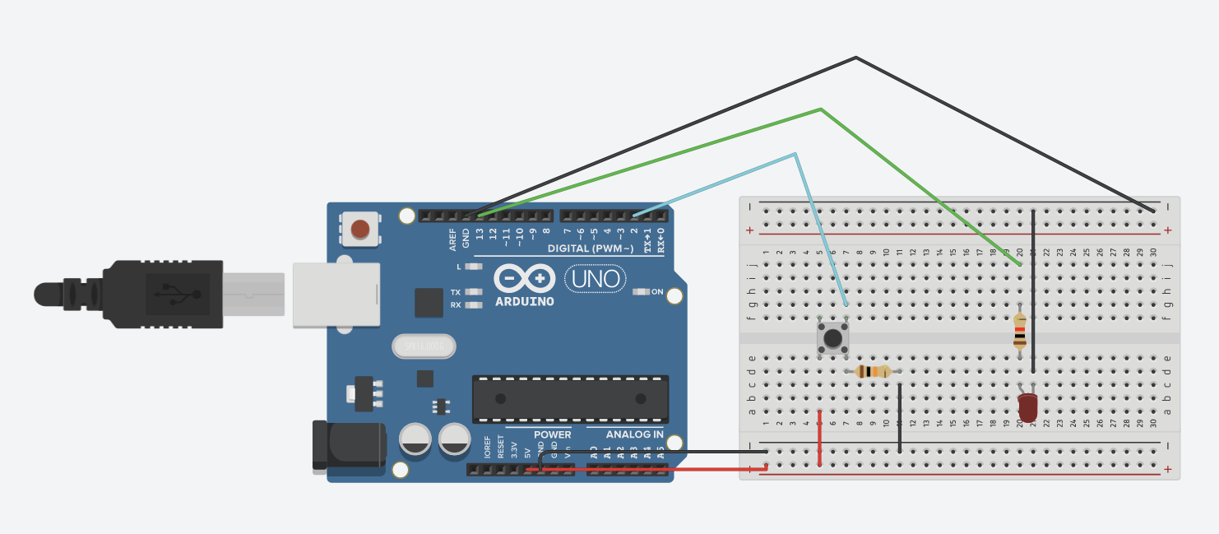
DIGITAL READ EXAMPLE - USE PUSH BUTTON TO CONTROL LED

Slide 38
REFERENCES
Tinkercad : https://www.tinkercad.com
Overview of Arduino Uno (along with tutorials) : https://docs.arduino.cc/hardware/uno-rev3
Short YT tutorial : https://youtu.be/BLrHTHUjPuw
Do remember, this is just an introduction. There is a lot more to learn
Once you are familiar with the basics, you can start learning more while doing projects

Slide 39
ROBOTIX
Facebook
Instagram
Website

Slide 40
ELECTRONIKA
Instagram
Facebook

